Slide 1


Air quality monitoring and management Workshop Air quality assessment in Italy: ISPRA activities in the EU directives framework
Giorgio Cattani
Italian National Institute for Environmental Protection and Research
Department for Environmental Evaluation, Control and Sustainability
Air quality monitoring unit

Slide 2
D.Lgs 155/2010 transposition directives 2008/50/EC – 2004/107/EC
Network of national and regional bodies
(art. 20 D. lgs 155/2010)
Ministry of environment
Ministry of Health
Regional competent authorities (19 regions and two autonomous provinces)
National association of Italian Municipalities
National association of Italian Provinces
technical-scientific institution:
National System for Environmental Protection (ISPRA and 21 Territorial Environmental Protection Agencies (ARPA / APPA)
Italian National Agency for New Technologies, Energy and Sustainable Economic Development
Italian National Institute for Health
National Research Council

Slide 3


ISPRA
Italian National Institute for
Environmental Protection and Research
Air quality monitoring and assessment in Italy
21 Regional administration
regional EPA (SNPA members)
Preliminary assessment
Establishment of zones and agglomerations
regional monitoring network planning and management
Data validation, regional assessment
Public information at regional level

Slide 4
Main ISPRA role
Support to the Ministry of environment in conformity evaluation of the regional delimitation into zones and agglomerations and relative classification updates
Cooperation with EEA for filling the gaps regarding air quality assessment and reporting (as EIONET NRC)
Guideline for air quality network development
Evaluation of conformity to EC Directives of the air quality regional networks projects and their updates
Assessment at national levels – trend analysis
National reference air quality laboratory (intercomparison, QA/QC)
National emission inventory
Notes:
The European Environment Information and Observation Network (Eionet) is a partnership network of the European Environment Agency (EEA) and its 38 member and cooperating countries.

Slide 5
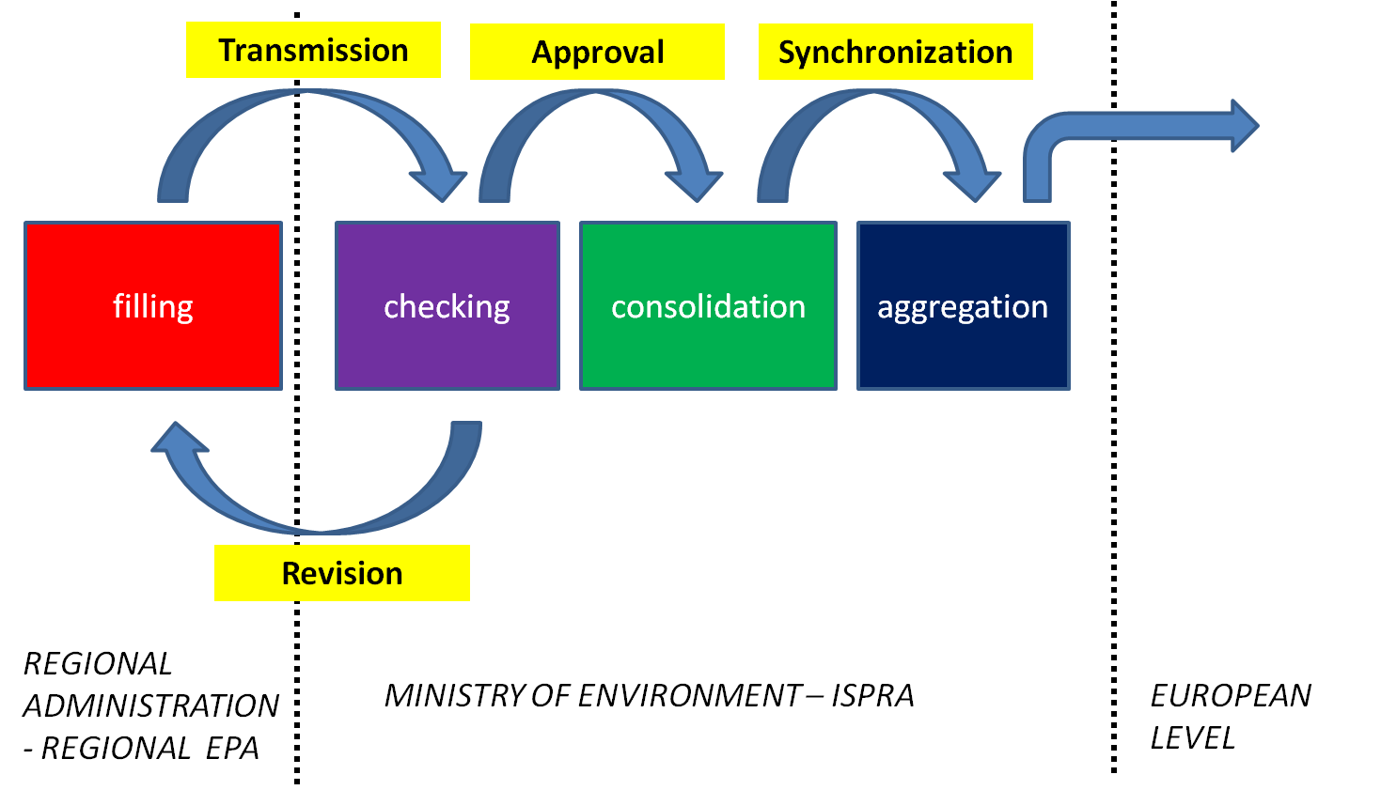
Reporting of official air quality information. Information submitted according to Directives 2004/107/EC and 2008/50/EC and decision 2011/850/EU.
Notes:
ISPRA organizes and makes available the national air quality data available that collects within the European Information Exchange (Exchange of Information, EoI).

Slide 6
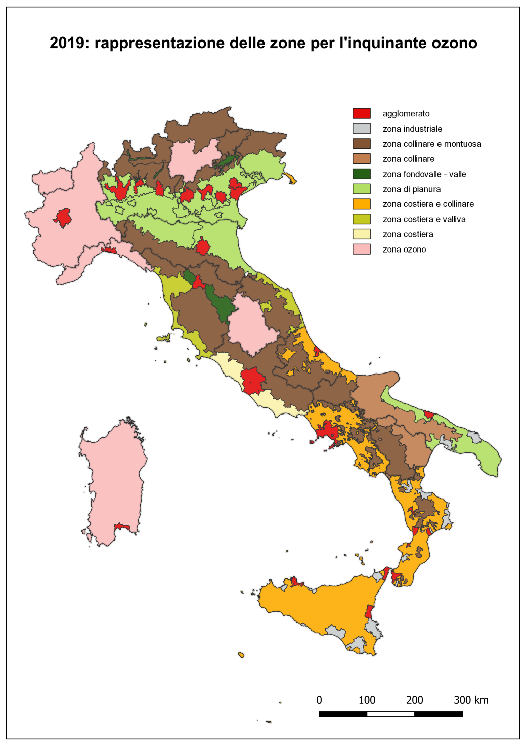
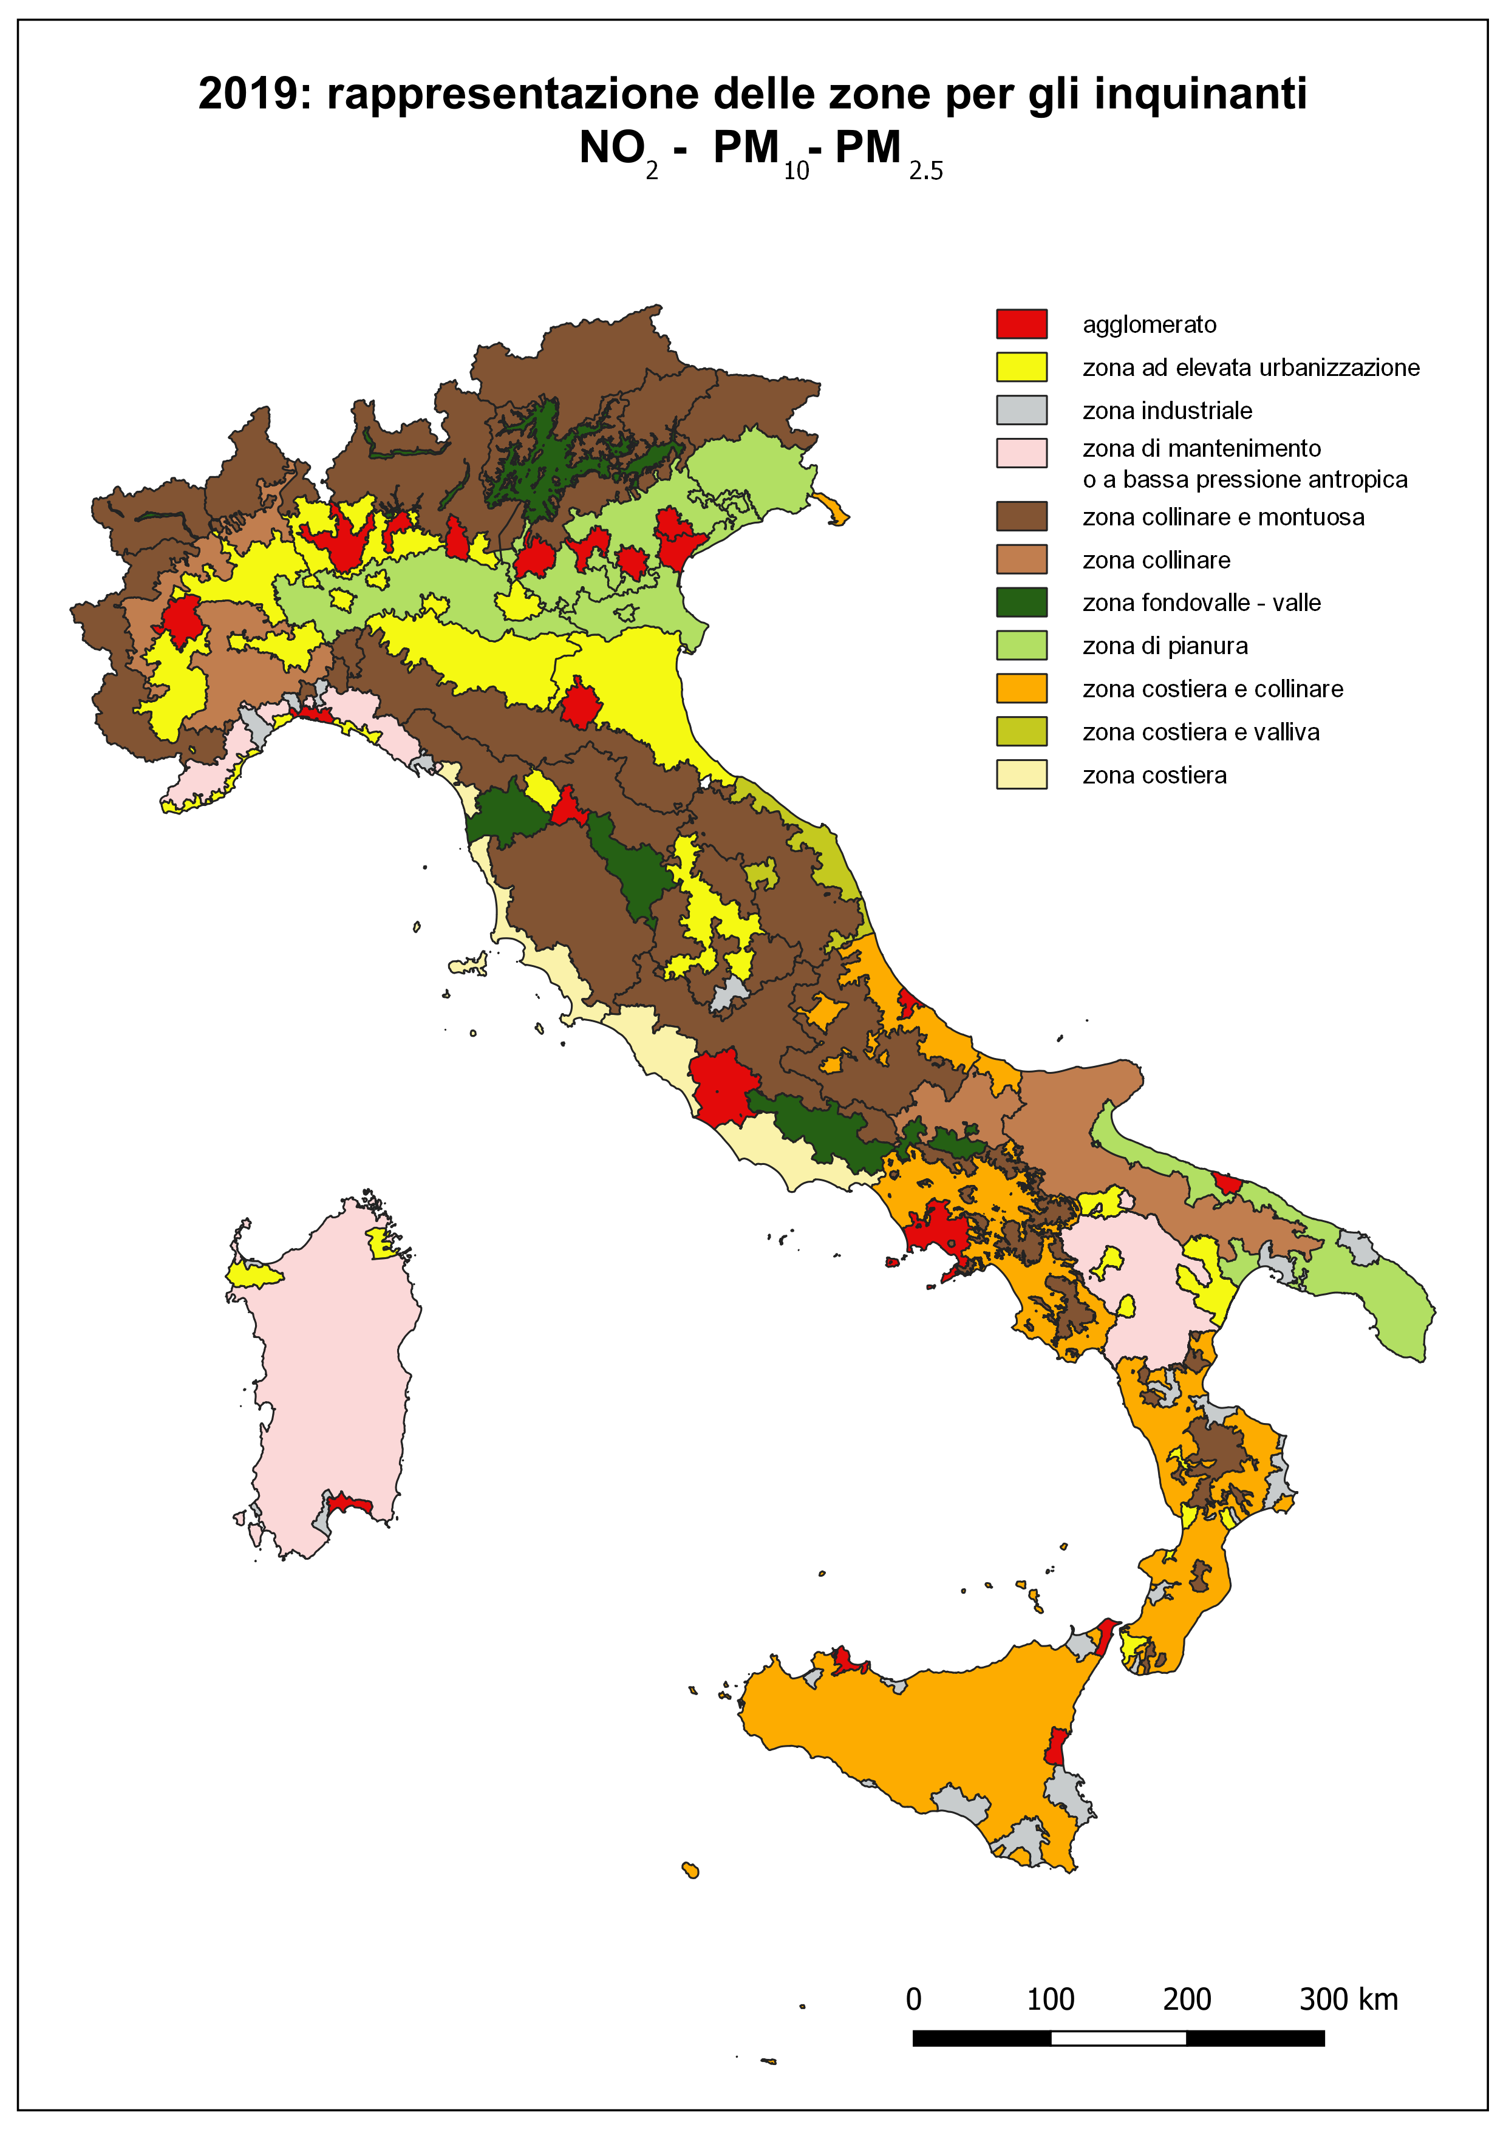
Italy Zone and agglomeration for ozone assessment
Italy Zone and agglomeration for NO₂, PM₁₀ and PM_{2.5}
Notes:
Member States shall establish zones and agglomerations throughout their territory. Air quality assessment and air quality management shall be carried out in all zones and agglomerations. each zone and agglomeration shall be classified in relation to assessment thresholds, based on preliminary assessment.
In all zones and agglomerations where the level of pollutants exceeds the upper assessment threshold established for those pollutants, fixed measurements shall be used to assess the ambient air quality. All the measurements shall respect data quality objectives and shall be performed following Reference measurement methods based on ISO-CEN standard.
Those fixed measurements may be supplemented by modelling techniques and/or indicative measurements to provide adequate information on the spatial distribution of the ambient air quality.

Slide 7
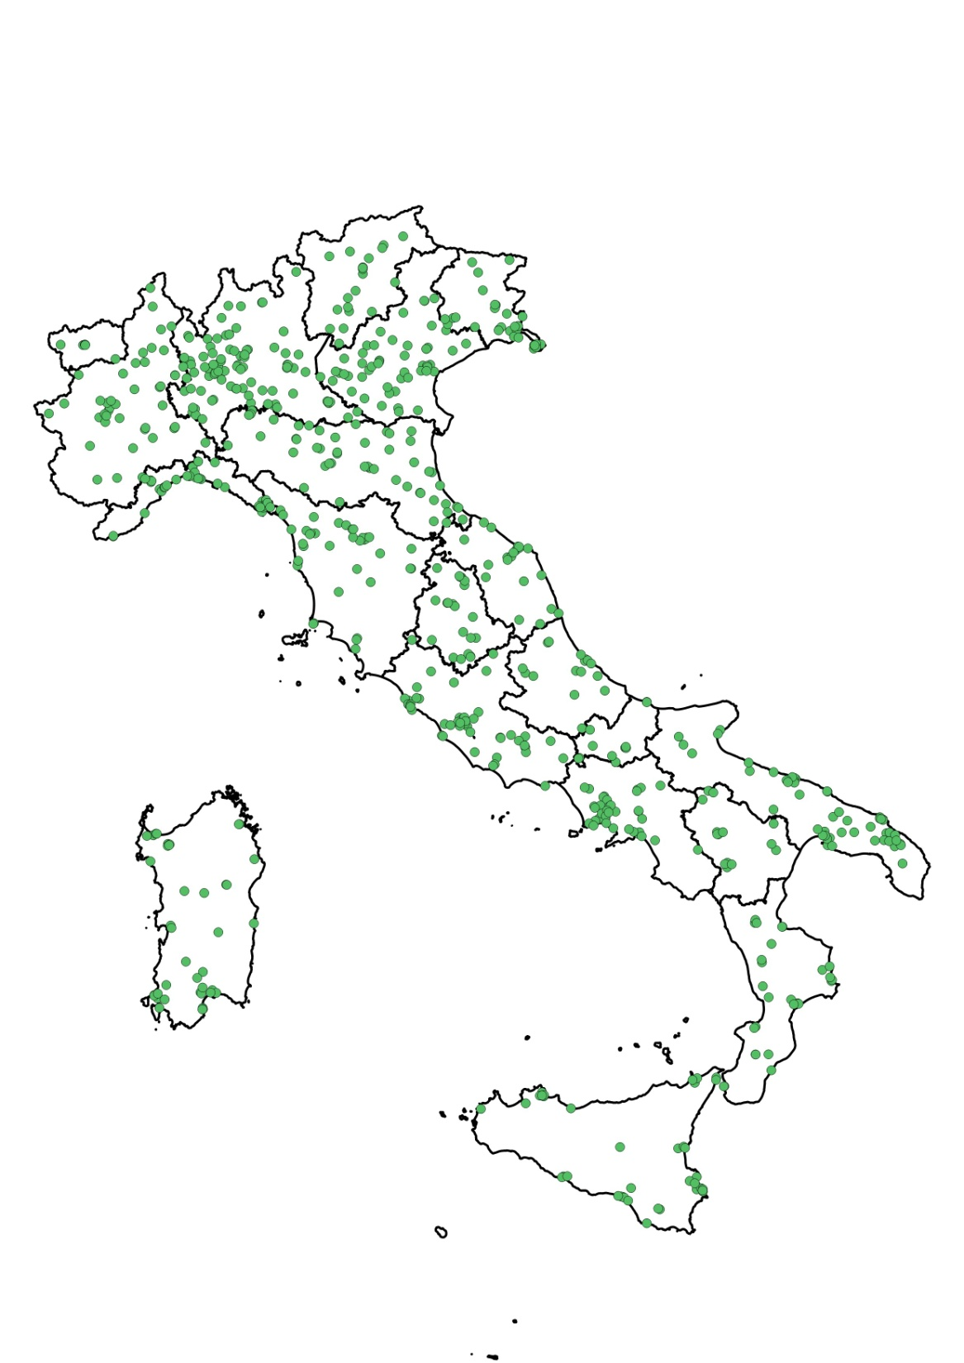
2020 – over 600 measuring stations used for the assessment of ambient air quality
Station kind by regions
Notes:
A correct location of monitoring equipments is a crucial aspect in air quality assessment.
Rules for macro and micrositing criteria to be adopted are provided and have to be strictly followed.
Sampling points directed at the protection of human health shall be sited in such a way as to provide data on the areas within zones and agglomerations where the highest concentrations occur to which the population is likely to be directly or indirectly exposed for a period which is significant in relation to the averaging period of the limit values; moreover sampling points representative of the exposure of the general population (urban or suburban background sites) as well as rural and regional background levels have to be implemented in the air quality network.

Slide 8
2020 – sampling points by pollutant

Slide 9
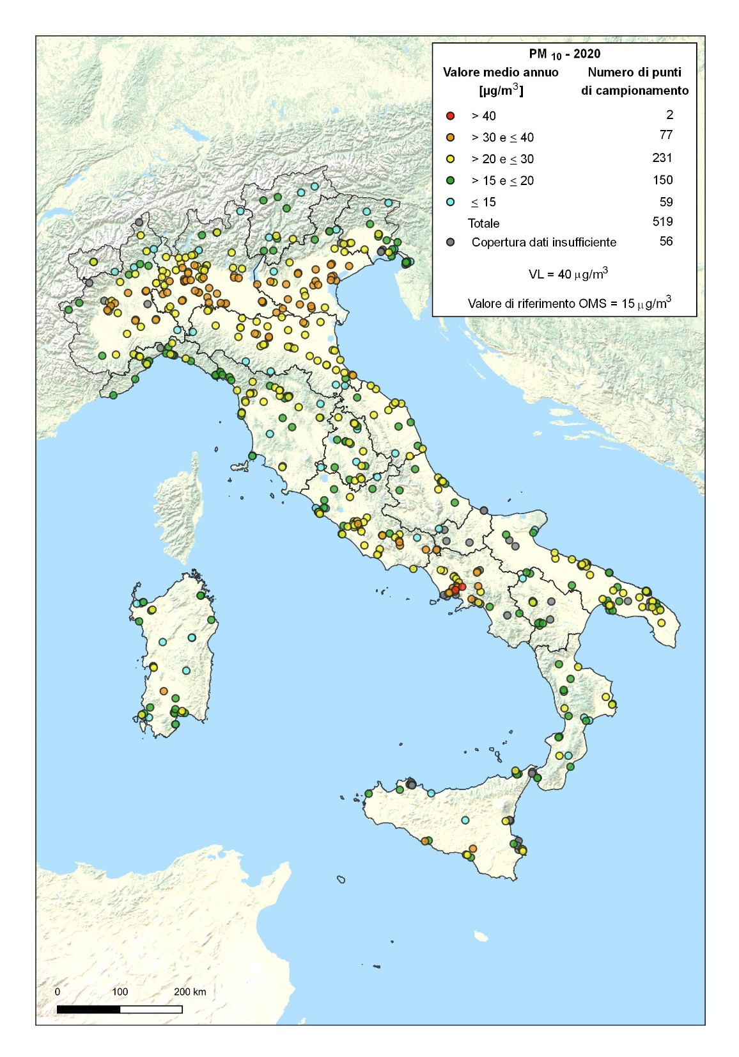
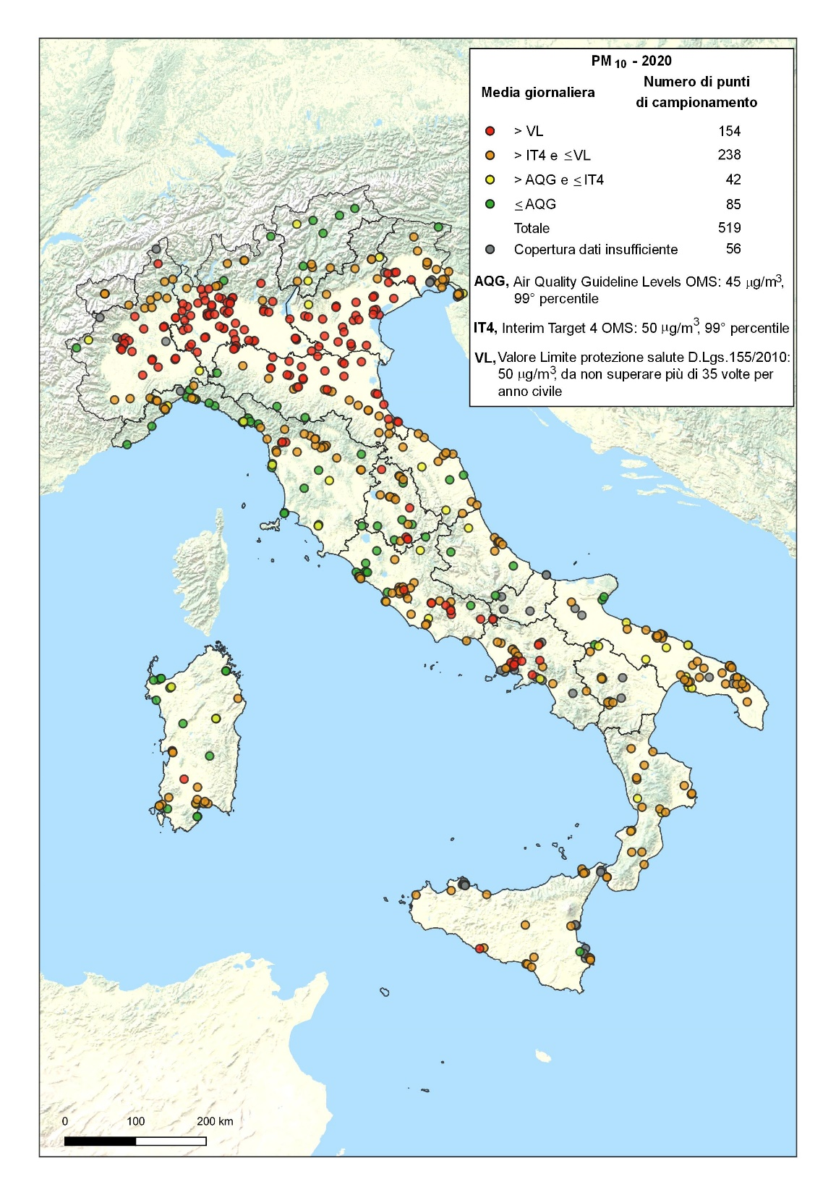
PM₁₀ – 2020
Annual mean
PM₁₀ – 2020
Daily exceedances
Annual limit exceedances: 2 stations (0.2%)
Daily limit exceedances: 154 stations (29.7%)
WHO short term AQG: 434 stations (83.6%)
WHO long term: 460 stations (88.6%)

Slide 10
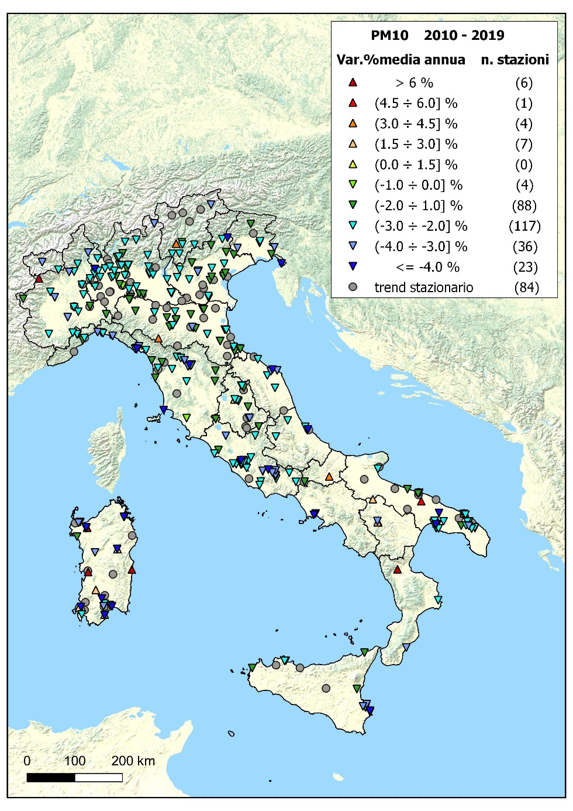
Italy, PM₁₀, 2010 - 2019: annual variation over 370 sites; trend analysis using seasonally adjusted Mann-Kendall test and Theil-Sen estimate of the slope
Statistically significant downward trend found at 268 sites out of 370
Average annual reduction:
2,5% (-6,6% ÷ -0,8%)
Notes:
In Italy a statistically significant moderate decreasing trend was found over the 2010-2019 period, in the majority of the PM10 time series, (Statistically significant downward trend found at 118 sites out off 169) time series. The trend is consistent with what was generally observed in Europe during the same period.

Slide 11
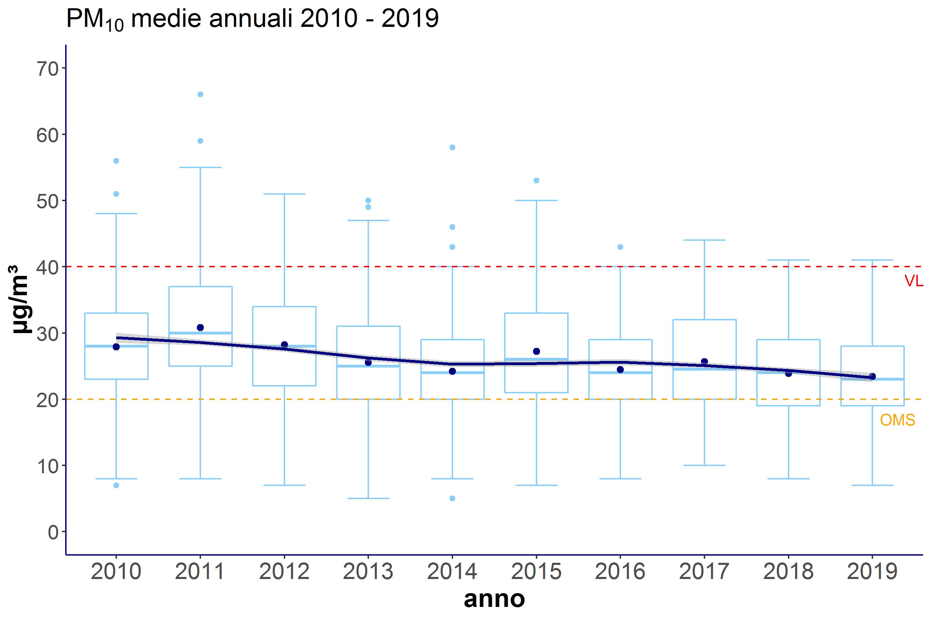
PM₁₀, 2010 - 2019. Distance to target.

Slide 12
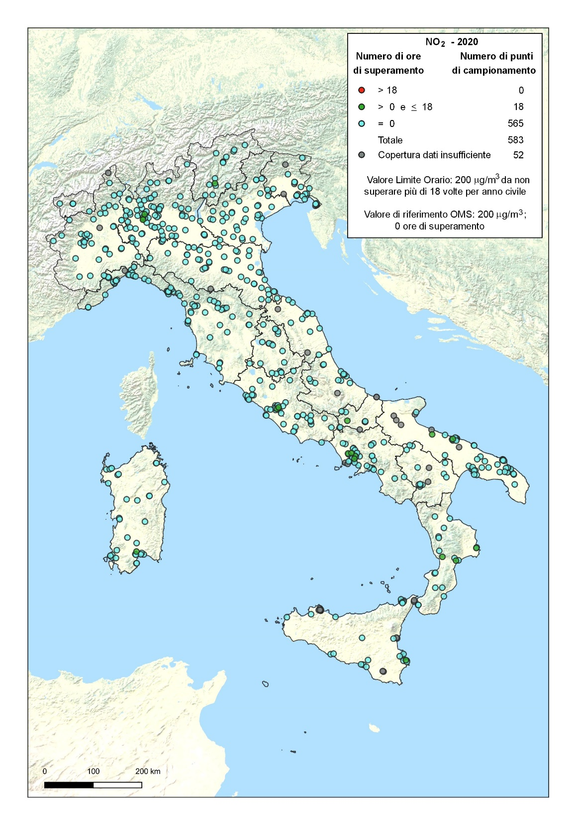
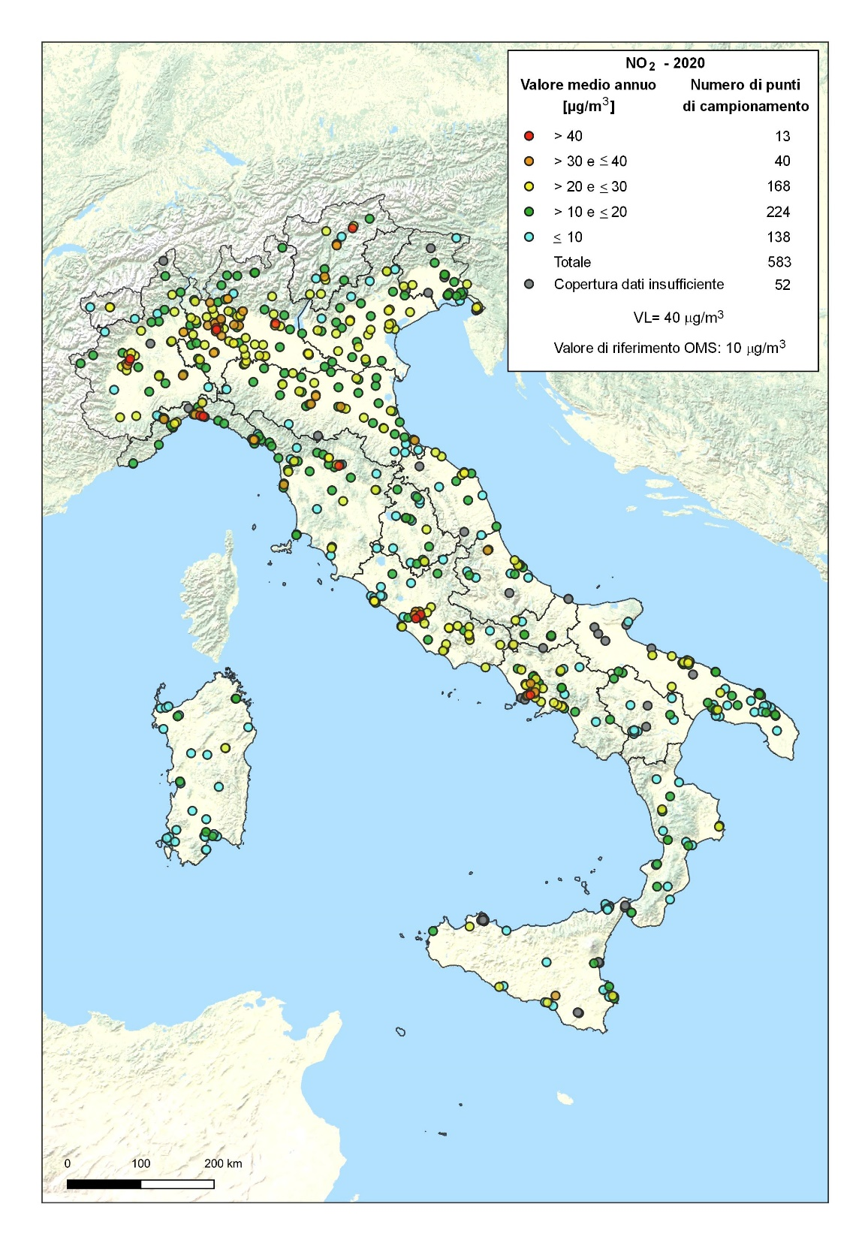
NO₂ – 2020
Houlry exceedances
NO₂ – 2020
Annual mean
Annual limit exceedances: 13 stations (2,2%)
hourly limit exceedances: none
WHO short term: 18 stations (3.1%)
WHO long term: 445 stations (76.3%)

Slide 13
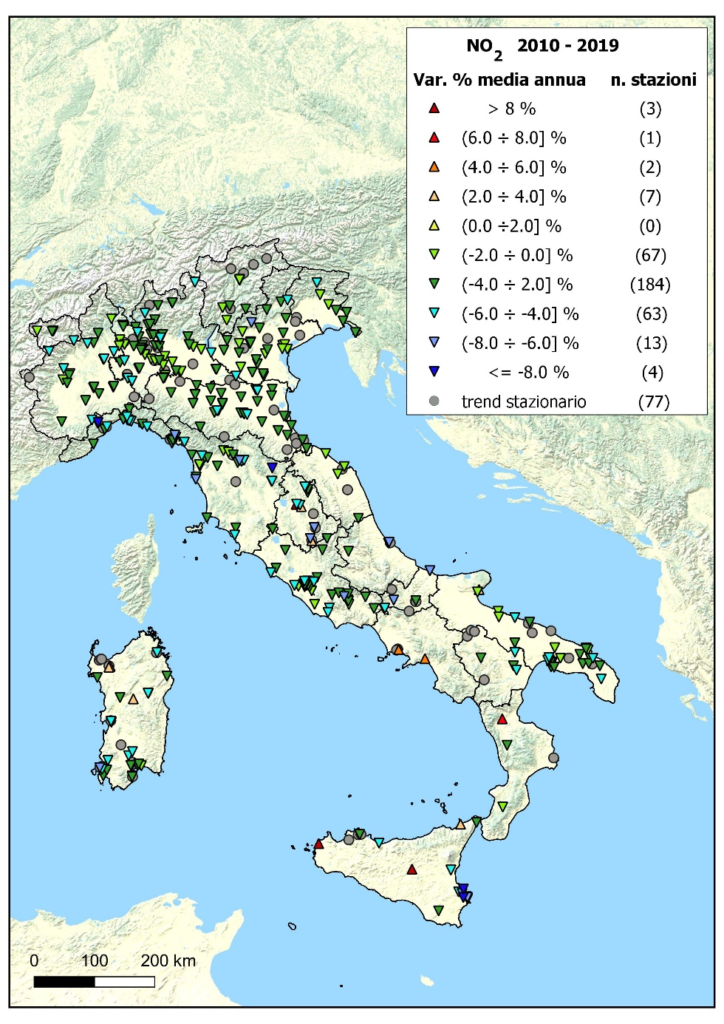
Italy, NO₂, 2010 - 2019: annual variation over 421 sites; trend analysis using seasonally adjusted Mann-Kendall test and Theil-Sen estimate of the slope
Statistically significant downward trend found at 331 sites out off 421
Average annual reduction:
3.1% (-6,6% ÷ -0,1%)

Slide 14
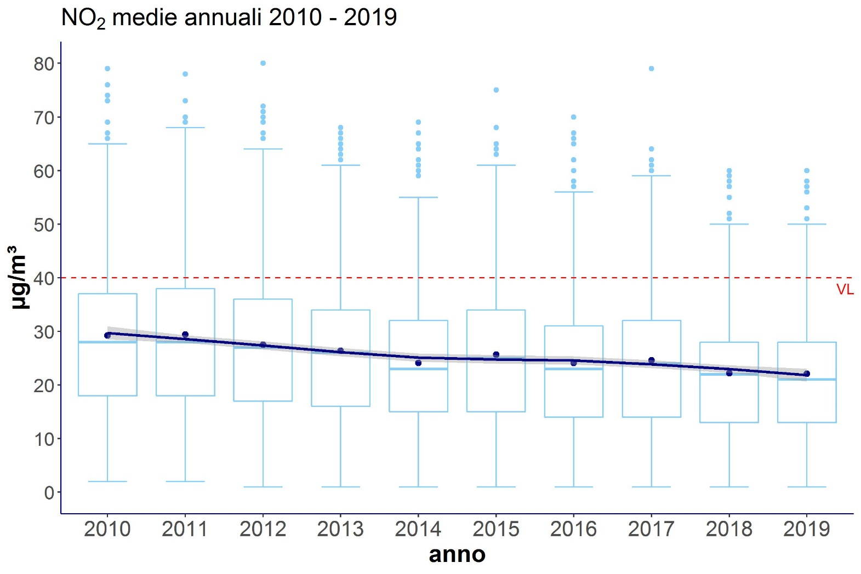
NO₂, 2010 - 2019. Distance to target.

Slide 15
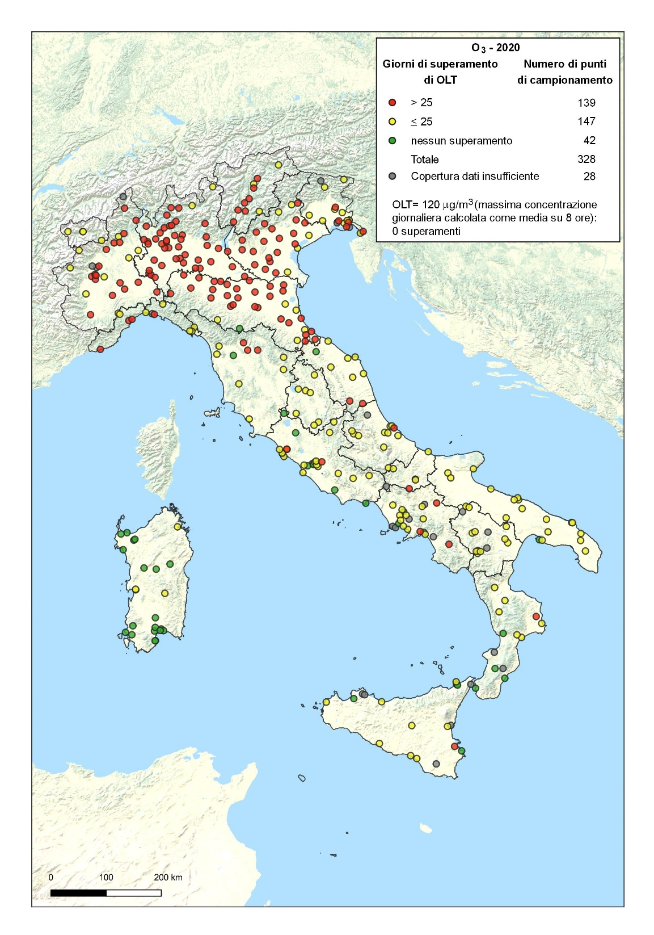
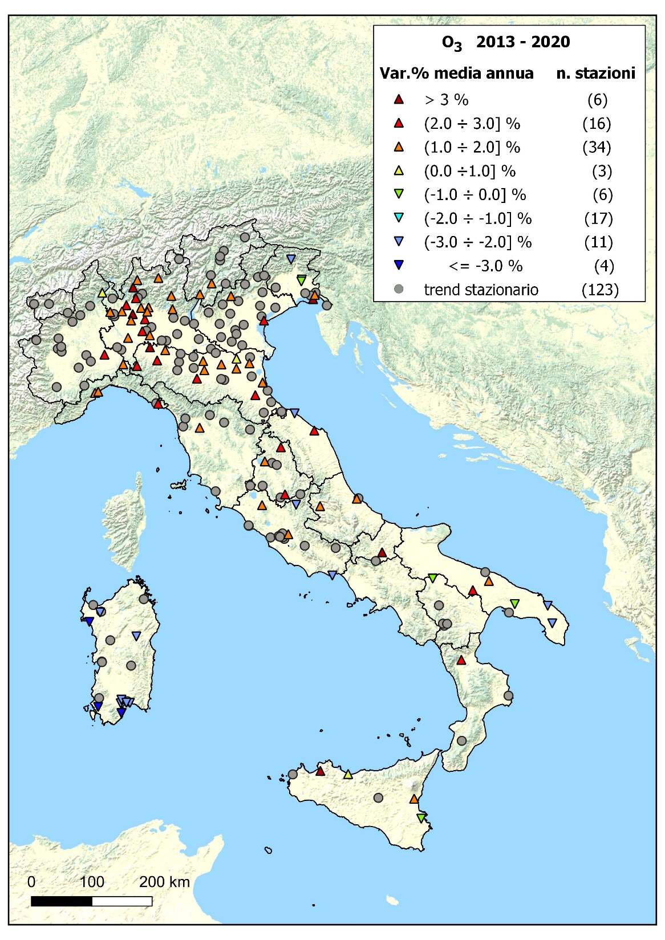
O₃ – 2010-2019 trend
O₃ – 2020
Long term objective daily exceedances

Slide 16
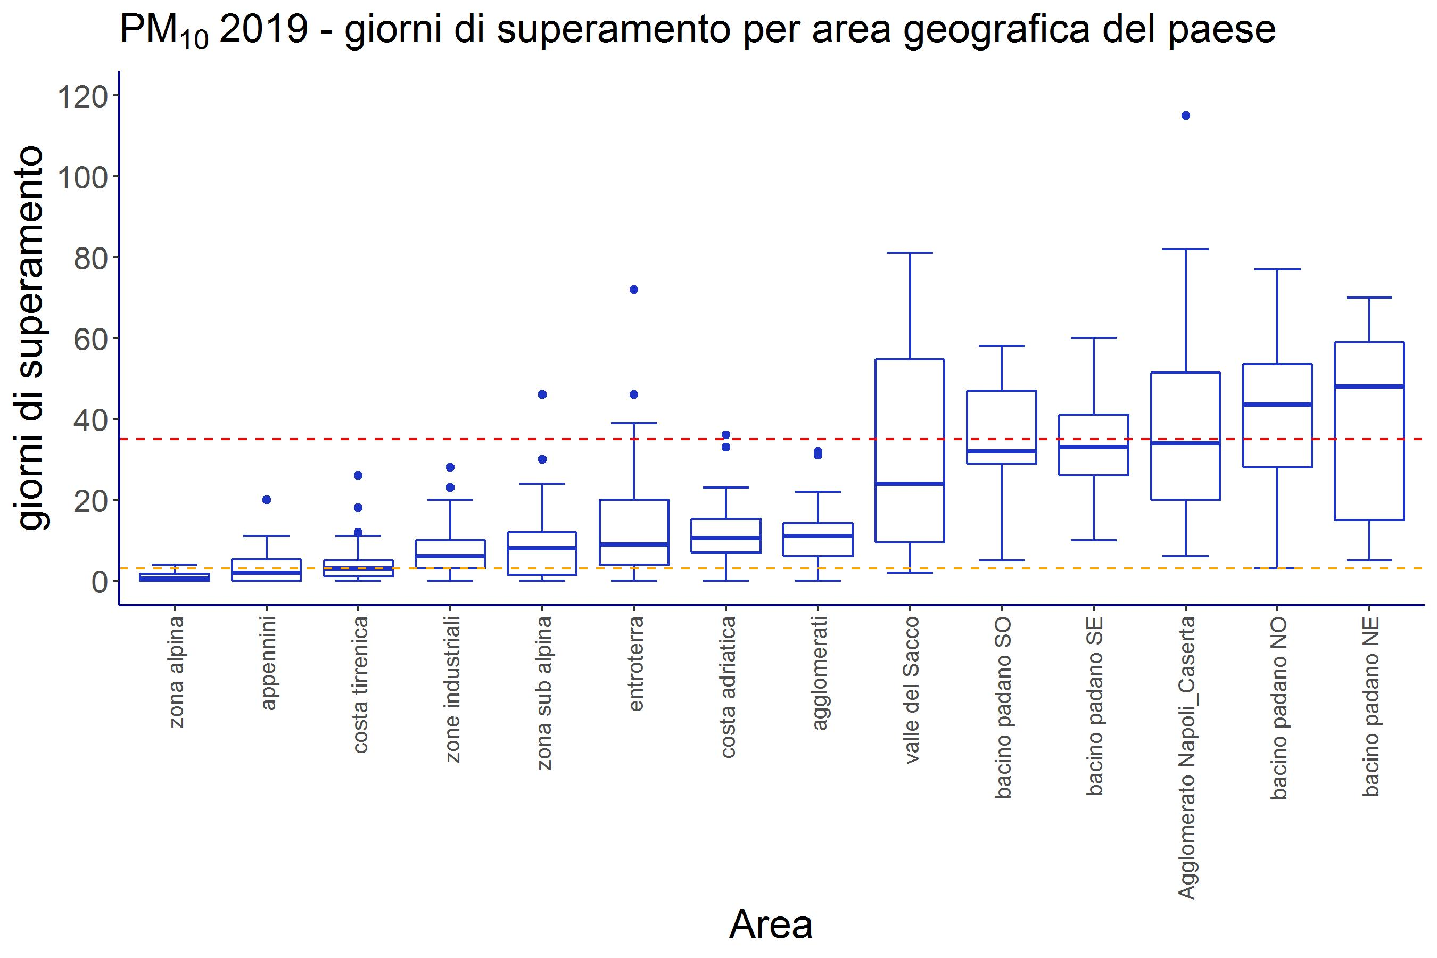
PM₁₀ – geographical exceedances distribution
Notes:
Sub-appennine hinterland, po –valley1

Slide 17
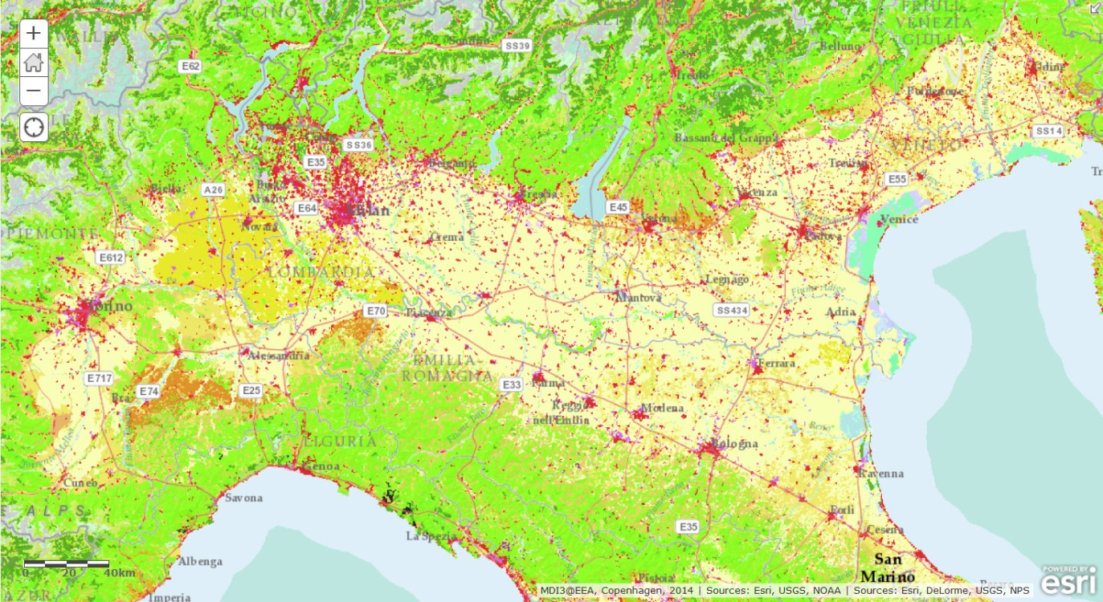
Main Po Valley features
47000 km², 20,000,000 inhabitants
Two main large urban agglomeration
Milan + 106 small town surroundings: 3,593,025
Turin + 31 small town surroundings: 1.555.778
8 medium sized urban agglomeration (260,000 – 600,000 inhabitants; 600 – 1500 inh/km²)
Overall high population density
Large arable land and permanent crops
Artificial areas
Arable land and permanent crops
pasture and mosaic
Forest land seminatural
Notes:
The Po valley extends over 47000 km² with 20,000,000 inhabitants. There are two main large urban agglomeration, Milan + 106 small town surroundings with 3,593,025 and Turin + 31 small town surroundings, with over 1000000 Inhabitants.
Moreover 8 medium sized urban agglomeration are spread over the area, quite close each other, with overall high population density. The area is largely devoted to intensive agricultural and livestock farming,.
The Po Valley produces ample amounts of NOx from vehicles, NH3 from agricultural activities, PM from residential heating, mainly from biomass burning devices and COV from solvent use in industry, vehicles and from agricultural activities due to biogenic emissions.

Slide 18
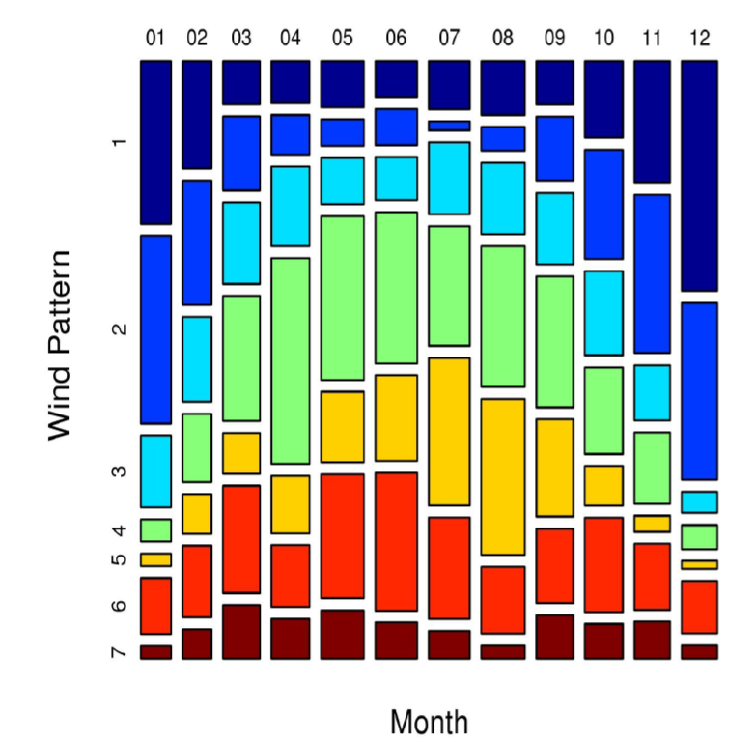
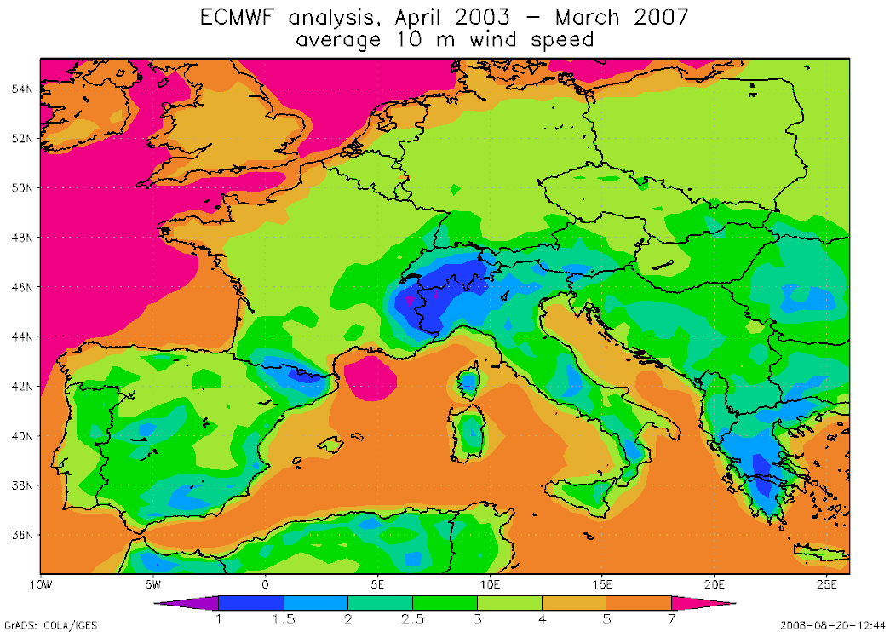
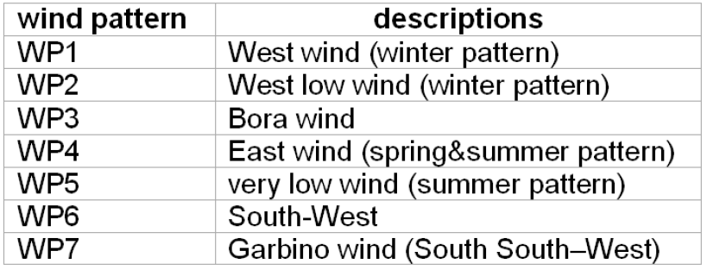
Typical wind pattern by month in the Po Valley and comparison with European 10 m wind speed averages
ISPRA
Italian National Institute for
Environmental Protection and Research
Notes:
The Alps and the Apennines often limit the air currents between Northern Italy and the rest of continental Europe. Feeble ventilation and wind-calm conditions (wind speed < 0.5 m/s) occur with a frequency higher than 50% through the year. Mechanical turbulence due to the wind is therefore generally low.

Slide 19
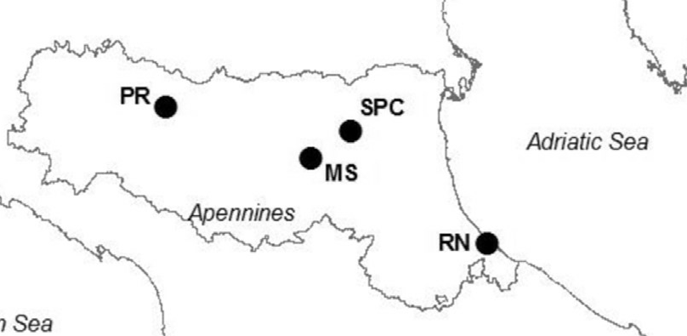
Mean seasonal hPBL calculated as average of the hourly estimates of the mixed layer and stable boundary layer thickness (during diurnal and nocturnal hours, respectively)
Ricciardelli I, Bacco D, rinaldi M et al. Atmospheric Environment 152 (2017) 418-430
Notes:
Particularly Winter seasons is characterized by, frequent thermal inversion at low altitude and low mixing layer heights, high pressure and calm wind conditions so that the area is frequently plunged in a stable and stagnant atmosphere.
At the same time, fog often forms in the valley in fall and winter when temperature inversions trap cool, moist and polluted air near the surface.
When fog forms, sulfur oxides, nitrogen oxides, and other polluting gases are taken up or ‘scavenged’ by fog water droplets. Once absorbed into the droplets, the gases oxidize more rapidly than they otherwise would, becoming sulfates, nitrates, and other types of aerosol particles. What the fog and humidity does is accelerate the process of converting gaseous pollutants into haze-causing aerosols.

Slide 20
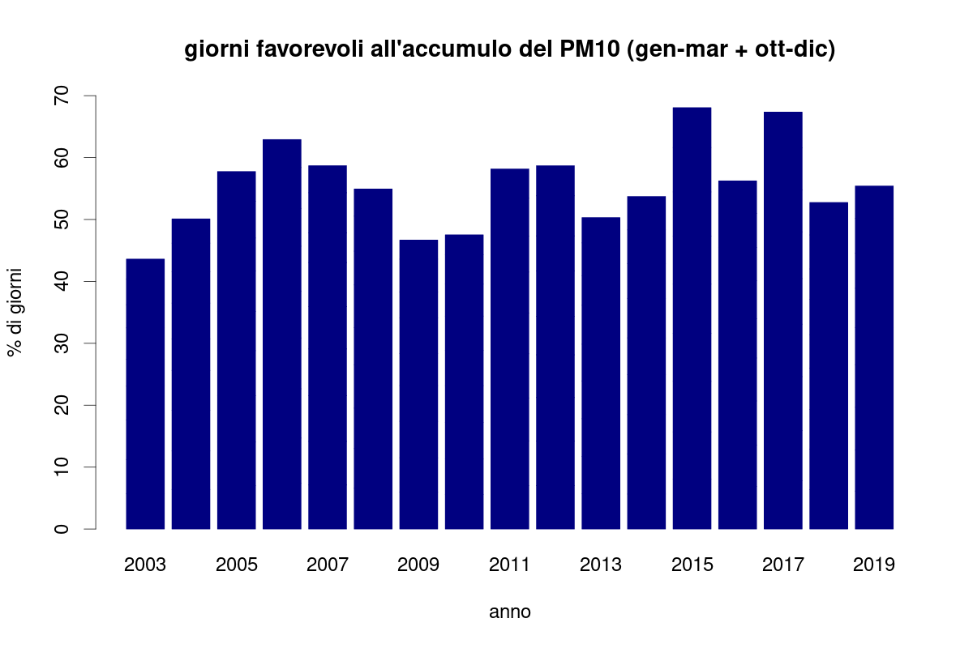
Emilia-Romagna (2003 – 2019). Cold season critical days for PM₁₀ exceedances
days without rain (precipitation <0.3 mm) in which the daily ventilation index, calculated as the product of the average daily mixing height and the average daily wind intensity, is less than 800 m2 / s.
Notes:
Such extreme conditions favorable to pollutant accumulation, can last several days, and usually are responsible for the rise in PM, NO2 and BaP concentration in the Po Valley.

Slide 21
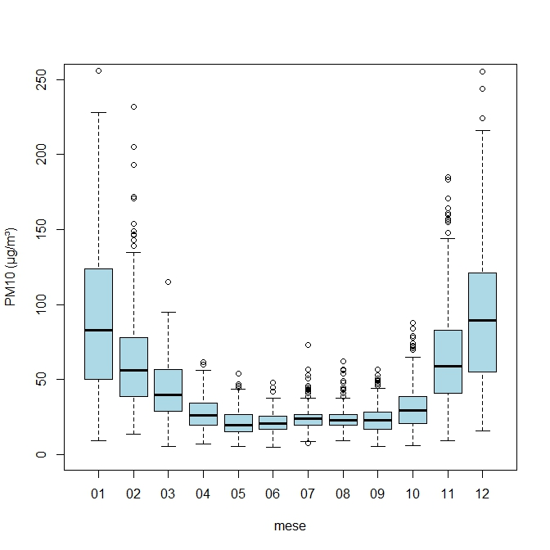
PM10 daily values by month - typical distribution Frosinone – Sacco Valley zone (2007 – 2016)
Inhabitants | 627.438
surface | 2976 km²
Population density | 211 hinabitants/km²
Emissions PM10 (Mg/ykm²) | 1.9
NO2 | 3.3
SO2 | 0.23
CO | 12.4
Fonte: elaborazioni ISPRA su dati ARPA LAZIO

Slide 22
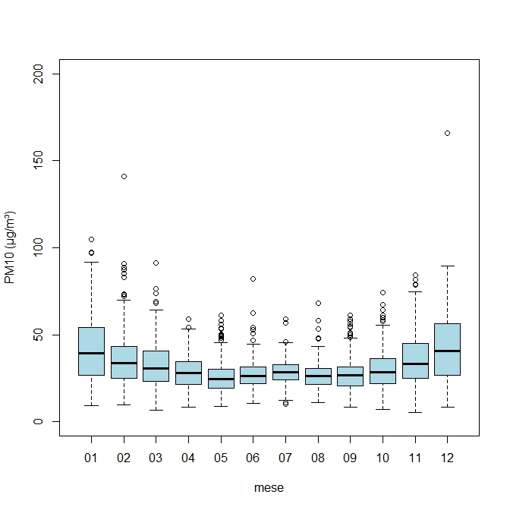
PM10 daily values by month - typical distribution Rome agglomerate zone (2007 – 2016)
Inhabitants | 3.514.210
surface | 2272 km²
Population density | 1546 hinabitants/km²
Emissions PM10 (Mg/ykm²) | 4.1
NO2 | 12.1
SO2 | 0.6
CO | 19.5
Fonte: elaborazioni ISPRA su dati ARPA LAZIO

Slide 23
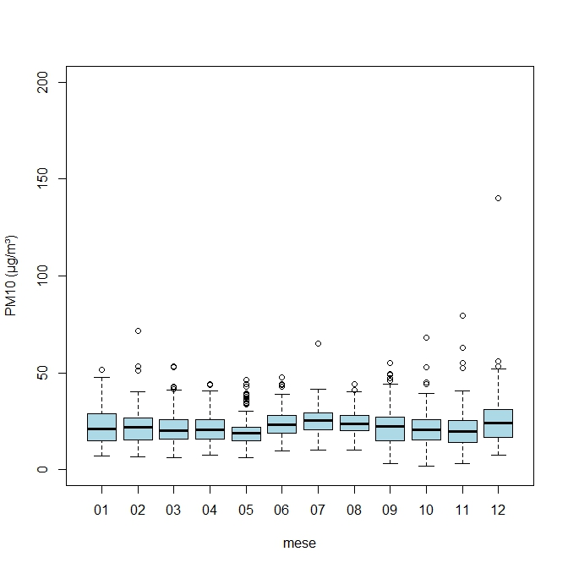
PM10 daily values by month - typical distribution Civitavecchia – coastal town zone (2007 – 2016)
Inhabitants | 1.196.305
surface | 4958 km²
Population density | 241 hinabitants/km²
Emissions PM10 (Mg/ykm²) | 1.4
NO2 | 3.2
SO2 | 0.55
CO | 9.2

Slide 24
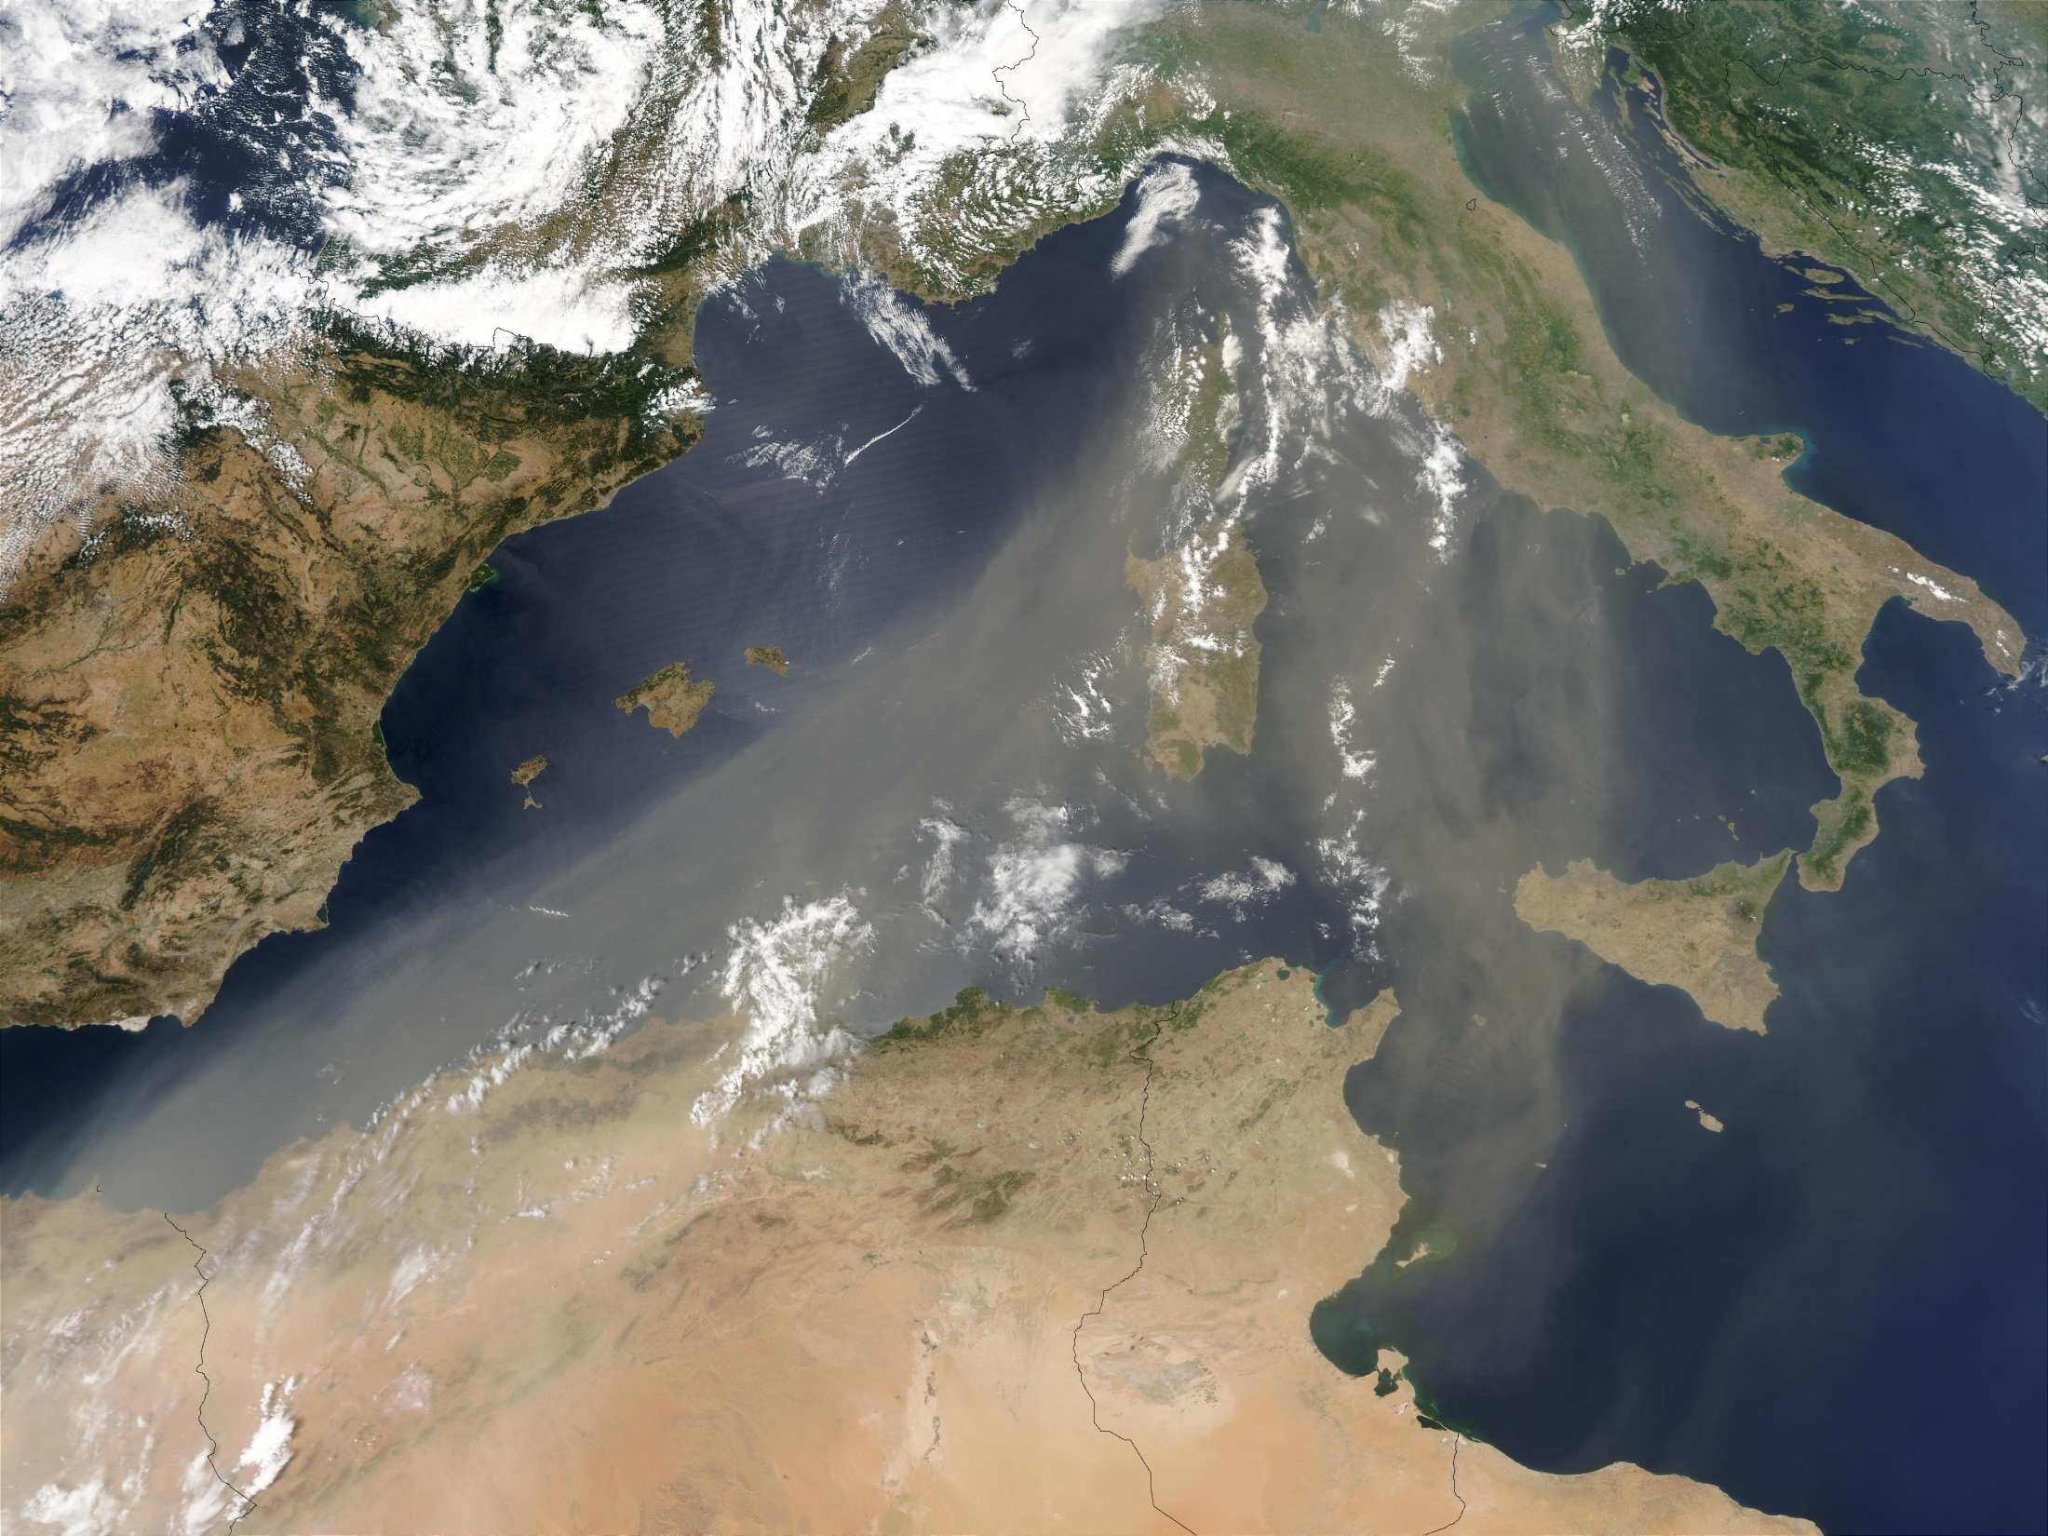
COMMISSION STAFF WORKING PAPER establishing guidelines for demonstration and subtraction of exceedances attributable to natural sources under the Directive 2008/50/EC on ambient air quality and cleaner air for Europe (EU - 2011)
Identifying Saharan dust outbreak episodes;
selection of regional background reference stations;
quantifying Saharan dust contribution in reference stations and daily PM₁₀ concentration in stations belonging to regional zones in exceedance;
subtraction of exceedances attributable to natural sources under the Directive 2008/50/EC.

Slide 25
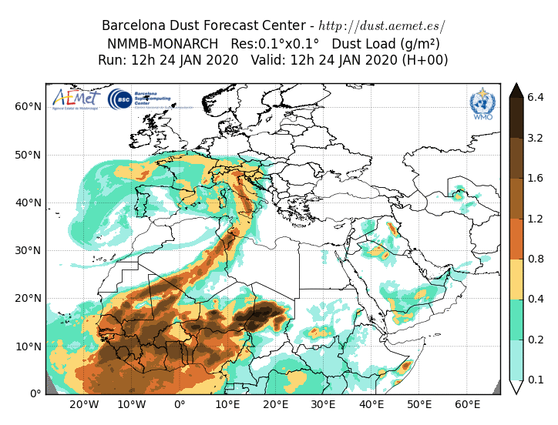
Identifying Saharan dust outbreak episodes
WMO – North Africa, middle Est, Europe Regional Center
Sand and dust storm warning advisory and assessment System
Barcelona Dust Forecast center
NMMB/MONARCH (già NMMB/BSC-Dust) (Pérez et al., 2011; Haustein et al., 2012)
Stime tri-orarie su griglia
10x10 km
available on-line as netcdf
Notes:
an online multi-scale atmospheric dust model designed and developed at the Barcelona Supercomputing Center (BSC-CNS) in collaboration with the NOAA's National Centers for Environmental Prediction (NCEP), the NASA's Goddard Institute for Space Studies and the International Research Institute for Climate and Society (IRI). The dust model is fully embedded into the Non-hydrostatic Multiscale Model NMMB developed at NCEP (Janjic, 2005; Janjic and Black, 2007; Janjic et al., 2011) and is intended to provide short to medium-range dust forecasts for both regional and global domains.

Slide 26
Selection of regional background reference stations
the maximum overlap between the days of event identified in the Candidate Reference Station (CRS) and the target station (TS);
the maximum correlation between the data series from the CRS and the considered TS;
the minimum distance between CRS station and TS;
the minimum difference in elevation between CRS and TS;
the maximum data coverage;
the minimum midspread (interquartile range).
African episode are then linked to AQ monitoring station
The statistical method is applied automatically by a matlab script for each networks stations

Slide 27
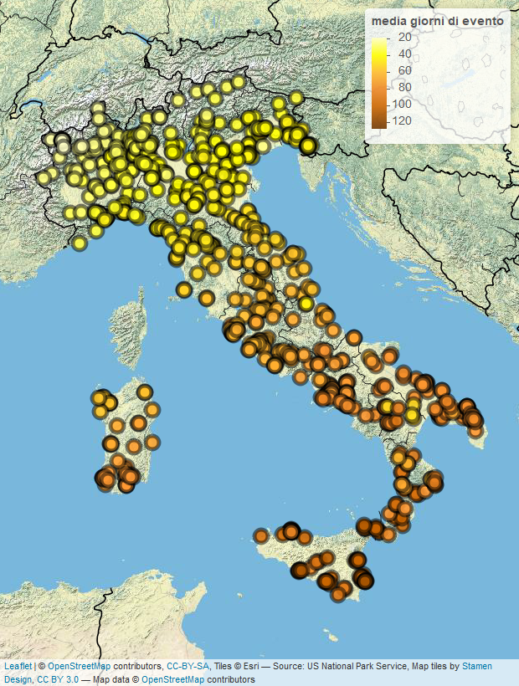
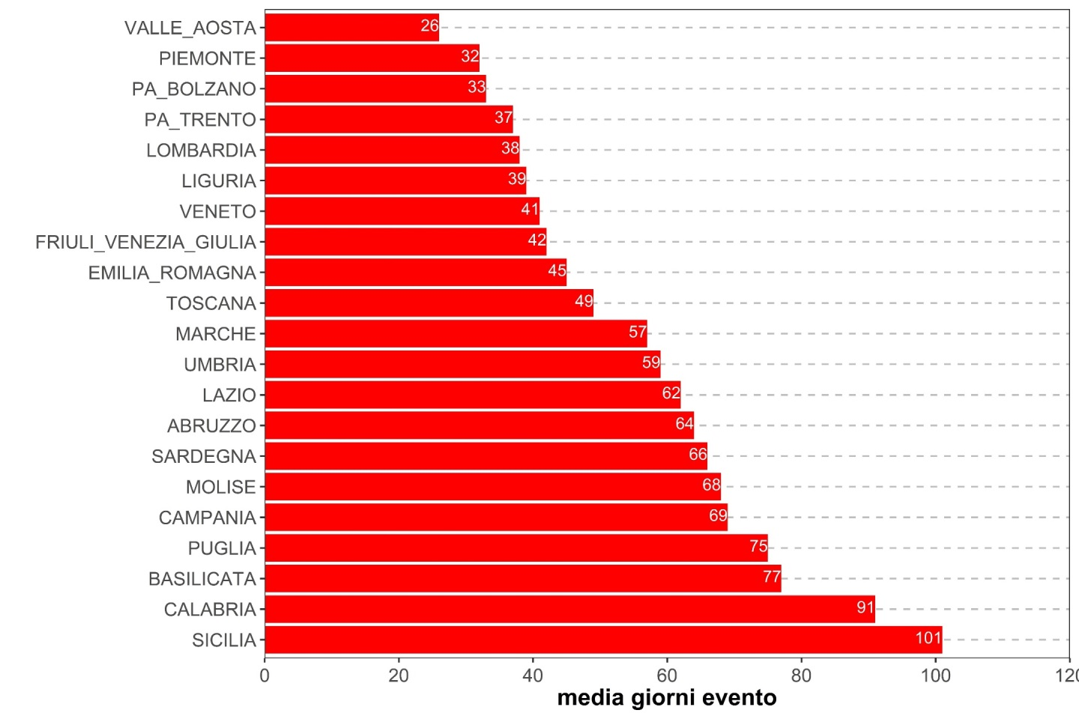
Average number of events by station and average number of events by region (2013 – 2020)

Slide 28
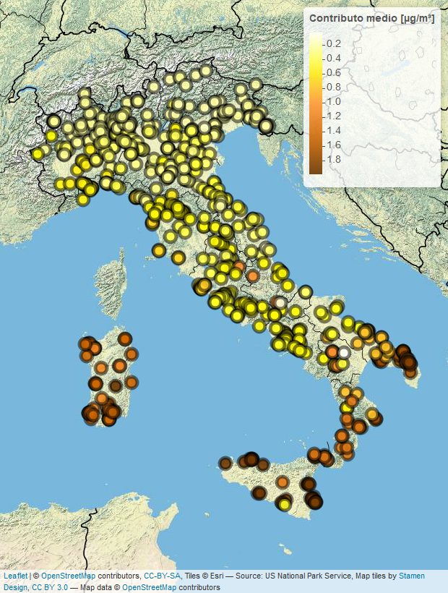
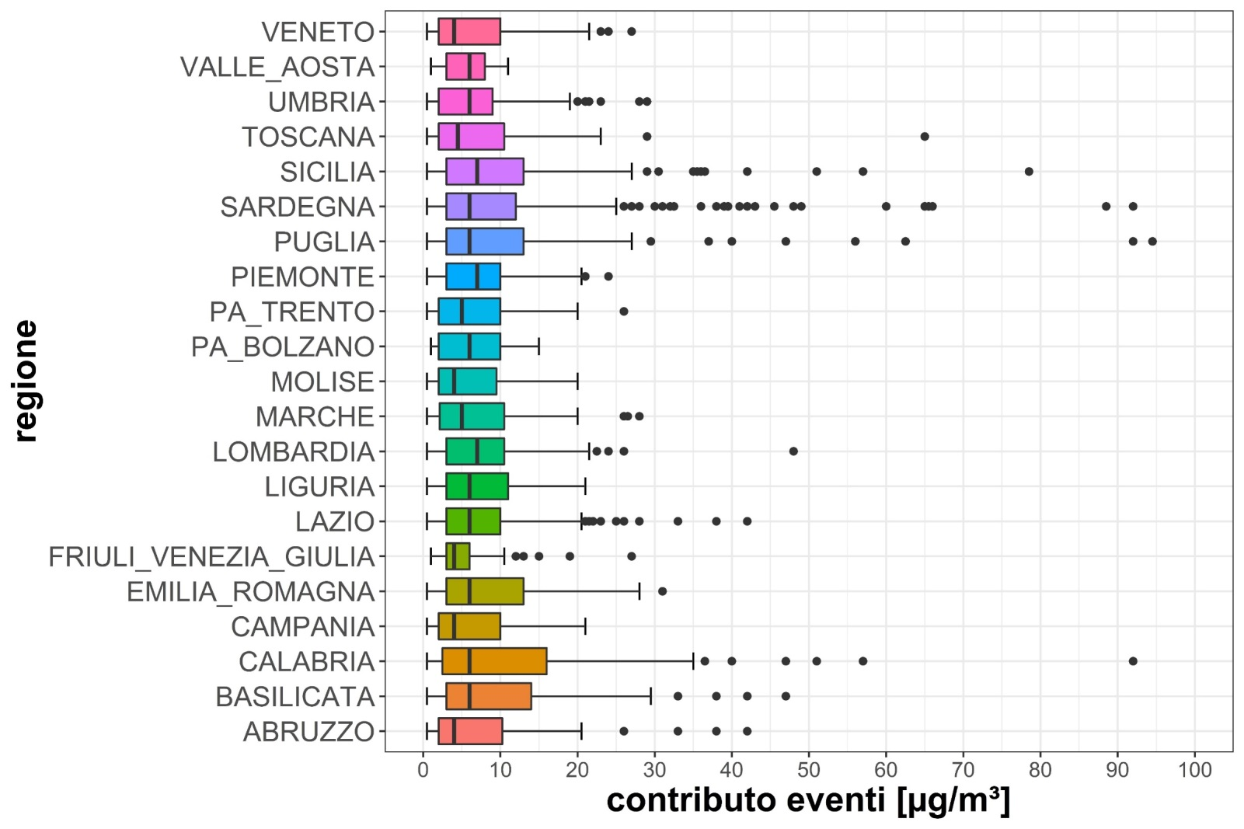
2018: Contribution to daily PM10 concentrations of events (by region, plot) and estimated contribution to the annual average (by station, map)

